Slide 1
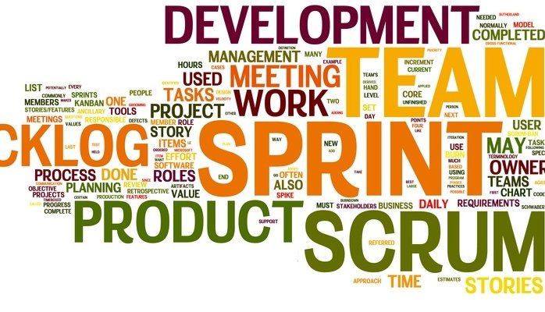
Agile

Slide 2
Agenda
Why Agile?
Principles and Values
Agile team
Product break down
Sprint
Story points and Velocity
Test Driven Development
Advantages

Slide 3
Software Testing Life Cycle - AppQA
Requirements Analysis
Understanding the purpose of the prebuild
Test reporting
Adhoc testing
Test Execution
Reporting bugs
Test Case design
Creating new test cases/steps
Test Case request Automation
Requesting for Automation
Test case submission
Adding test cases into production
Prebuild get
submitted to Devel

Slide 4
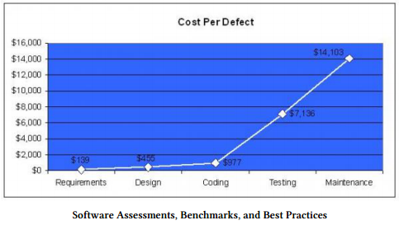
Capers Jones

Slide 5
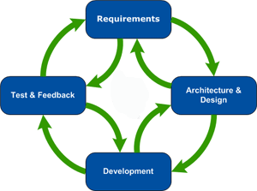
Software Development Life Cycle – Agile Model
Start
End

Slide 6
Principles and Values
While process and tools are important, individuals and interactions are more important.
While sufficient documentation is important, working software is more important.
The best architectures, requirements and designs emerge form self organized teams.
Deliver working software frequently. Every couple of months is good, but every couple of weeks is better.
Business people and developers must work together daily throughout the project.
Planning is important, but responding to change is more important.

Slide 7
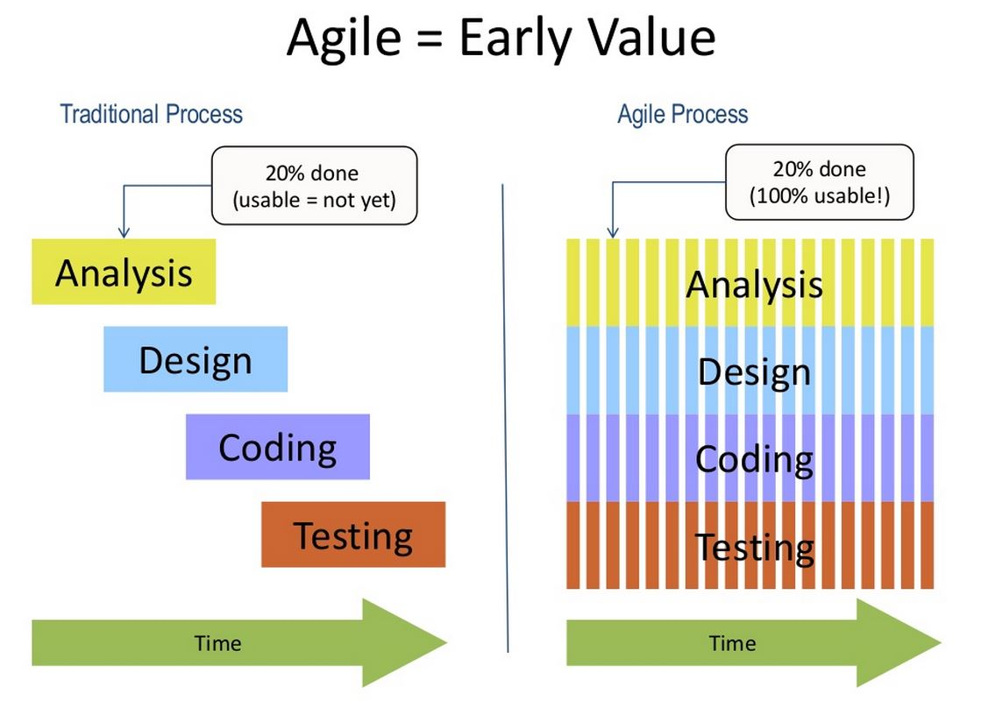
Waterfall Vs Agile

Slide 8
Agile Team
Scrum Master
Product Owner
1 or more persons from Engineering
1 or more persons from QA

Slide 9
Product break down
Vision – Objectives that is simply understandable. Written in plain English.
Epic – Distinct value/feature of each objective.
User Story – A description that everybody can understand, includes Who, What and Why.

Slide 10
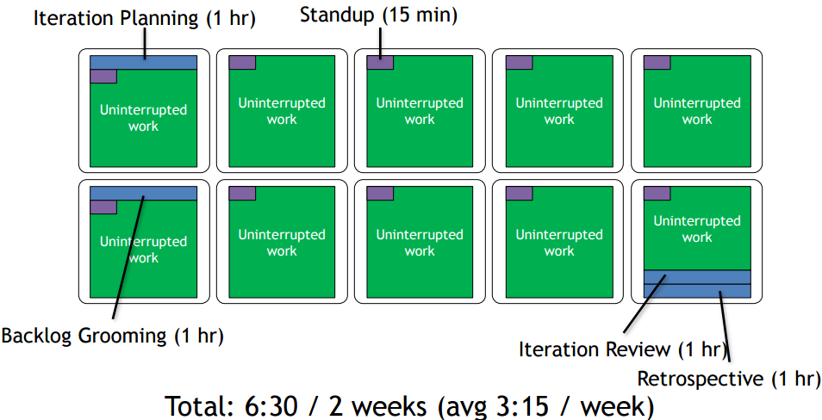
Sprint
Ready to Done

Slide 11
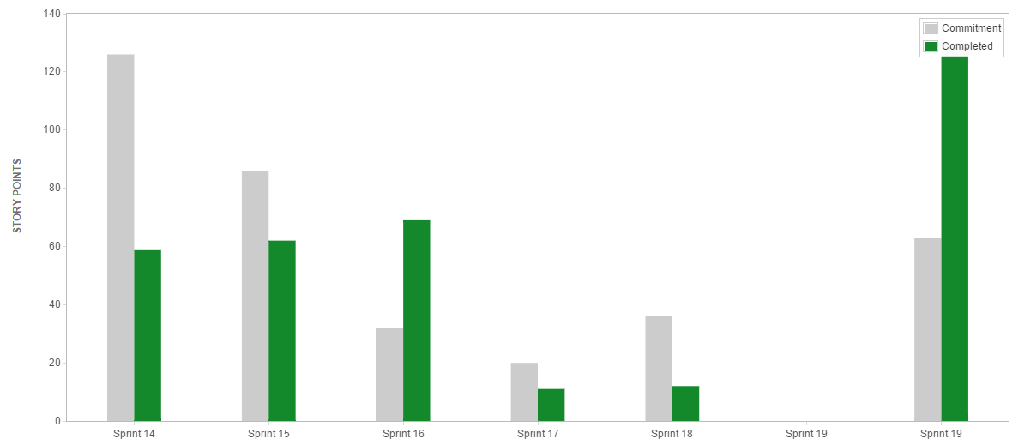
Story Points and Velocity
Relative complexity.

Slide 12
TDD
Programmers write unit tests prior to coding.
If you can’t write a test, you aren’t ready to code.
Writing tests first will change how you write code.
Writing tests after coding is “too late”.
Writing test cases prior to writing should also be considered.
We can also write scripts before coding.

Slide 13
Advantages
Team Collaboration
Test Automation
Quality Product
Reduced cost

Slide 14
Retrospective

Slide 15
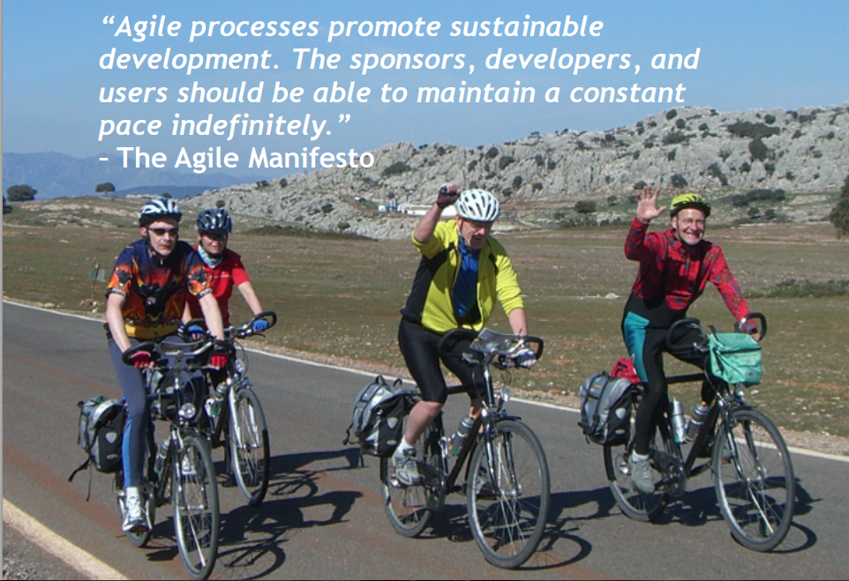
Thank You

